Slide 1
Persuasive speech Author Institutional Affiliation Instructor Course code Date of submission

Slide 2
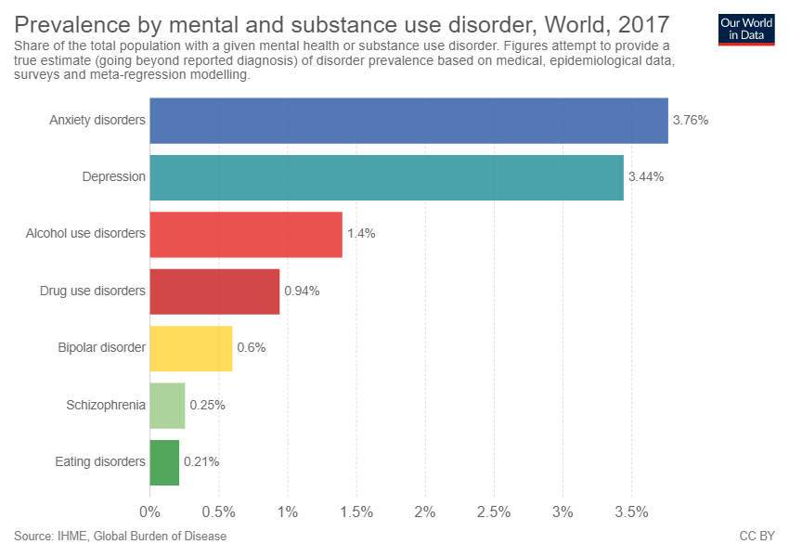
Prevalence of mental health issues

Slide 3
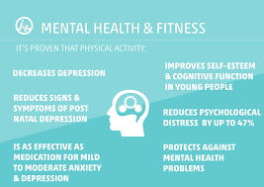
The beneficial impacts of exercises on mental health

Slide 4

Exercises make us happy and therefore free from depression

Slide 5


Slide 6


Slide 7
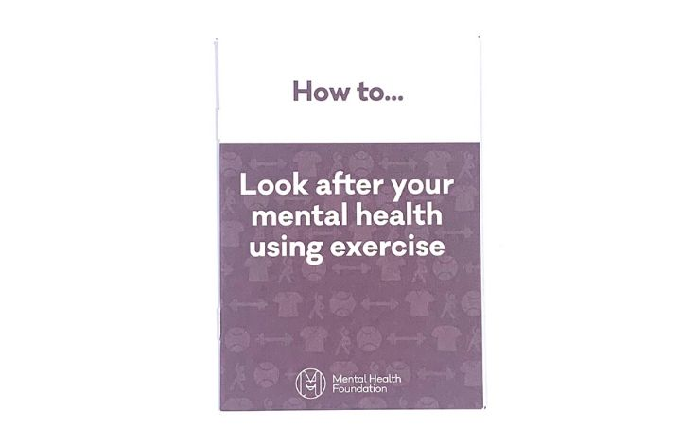
Conclusion

